Slide 1
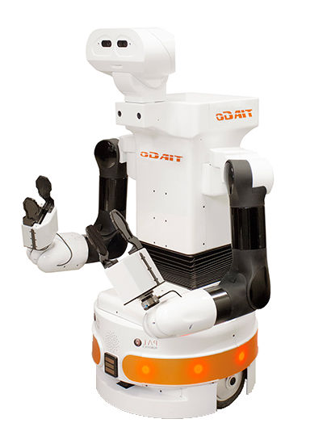
Robot Navigation With Precedence
Software Architectures For Robotics
A.Y. 2021/22
Matteo Maragliano (4636216)
Mattia Musumeci (4670261)
Daniele Martino Parisi (4670964)

Slide 2

Introduction
The objective is to develop an architecture that allows two robots to navigate inside a real-world environment while avoiding collisions.
In particular, the robots must avoid collision between each other by giving the right of way according to a policy rule.
This behavior is obtained through a policy controller which enforces the policy rule and decides which one, between the two robots, has the right of way in case they reach an intersection at the same time.

Slide 3

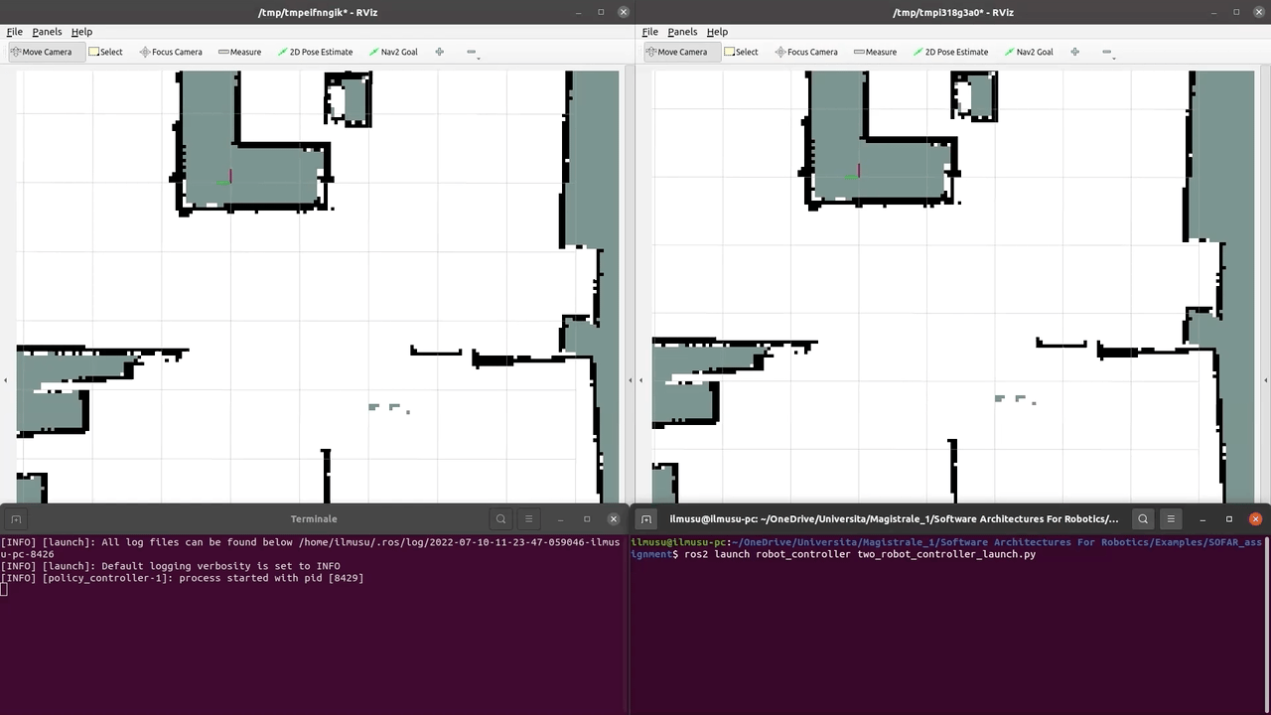
Video Demonstration

Slide 4

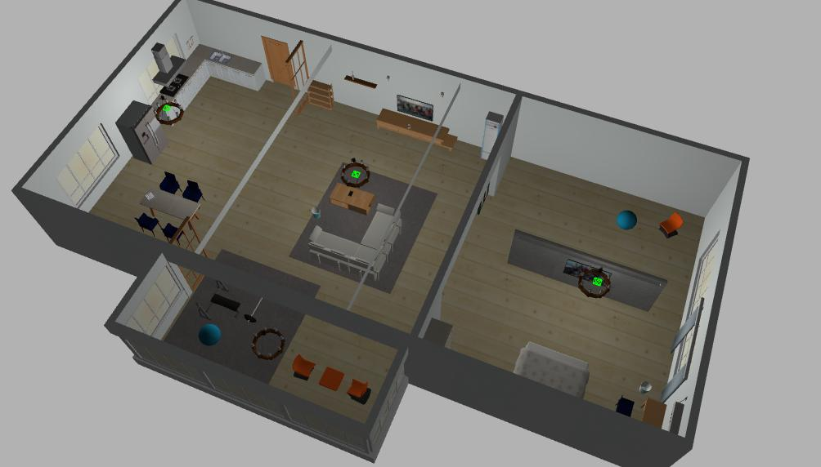
Environment

Slide 5

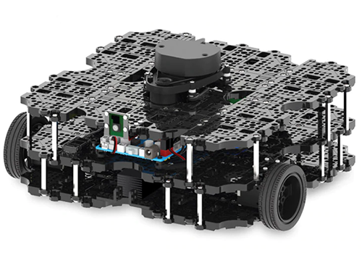
Robot Used
The software has been tested with the TurtleBot3 Waffle, which is a small, affordable and programmable robot based on ROS.
While navigating, it runs SLAM algorithms to dynamically build a map of the environment and localize itself.
TurtleBot 3 Waffle

Slide 6

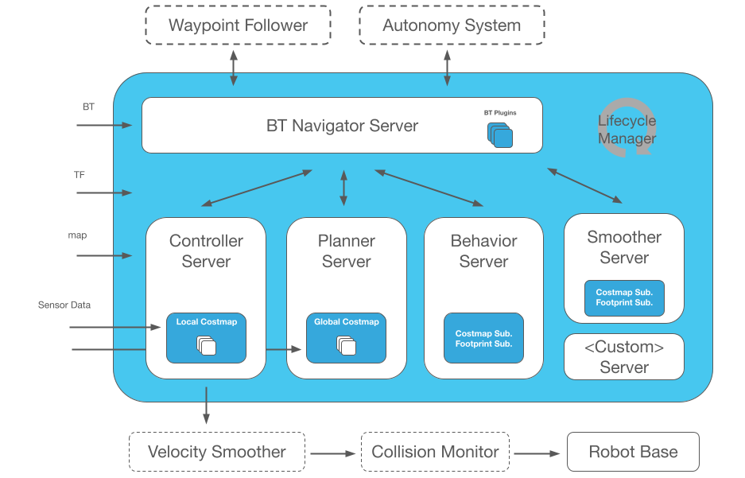
Nav2
Nav2 is a set of libraries which aims to safely navigate a robot in the environment it is in.
It uses ROS2 as a middleware.
It is based on the core concept of Behavior Trees (BT) which make calls to modular servers to complete different action.

Slide 7
Nav2
The servers at the heart of the navigation stack are the following:
The behavior server which builds root behaviors using behavior trees.
The planner server which plans a path to a goal while avoiding obstacles.
The smoother server which smooth paths to be more continuous and feasible.
The controller server which controls the robot as it follows the path.

Slide 8
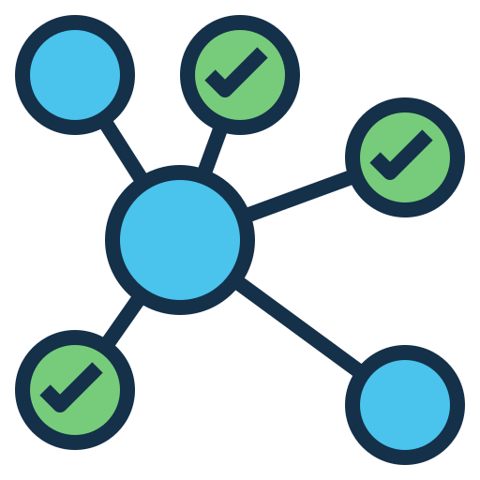
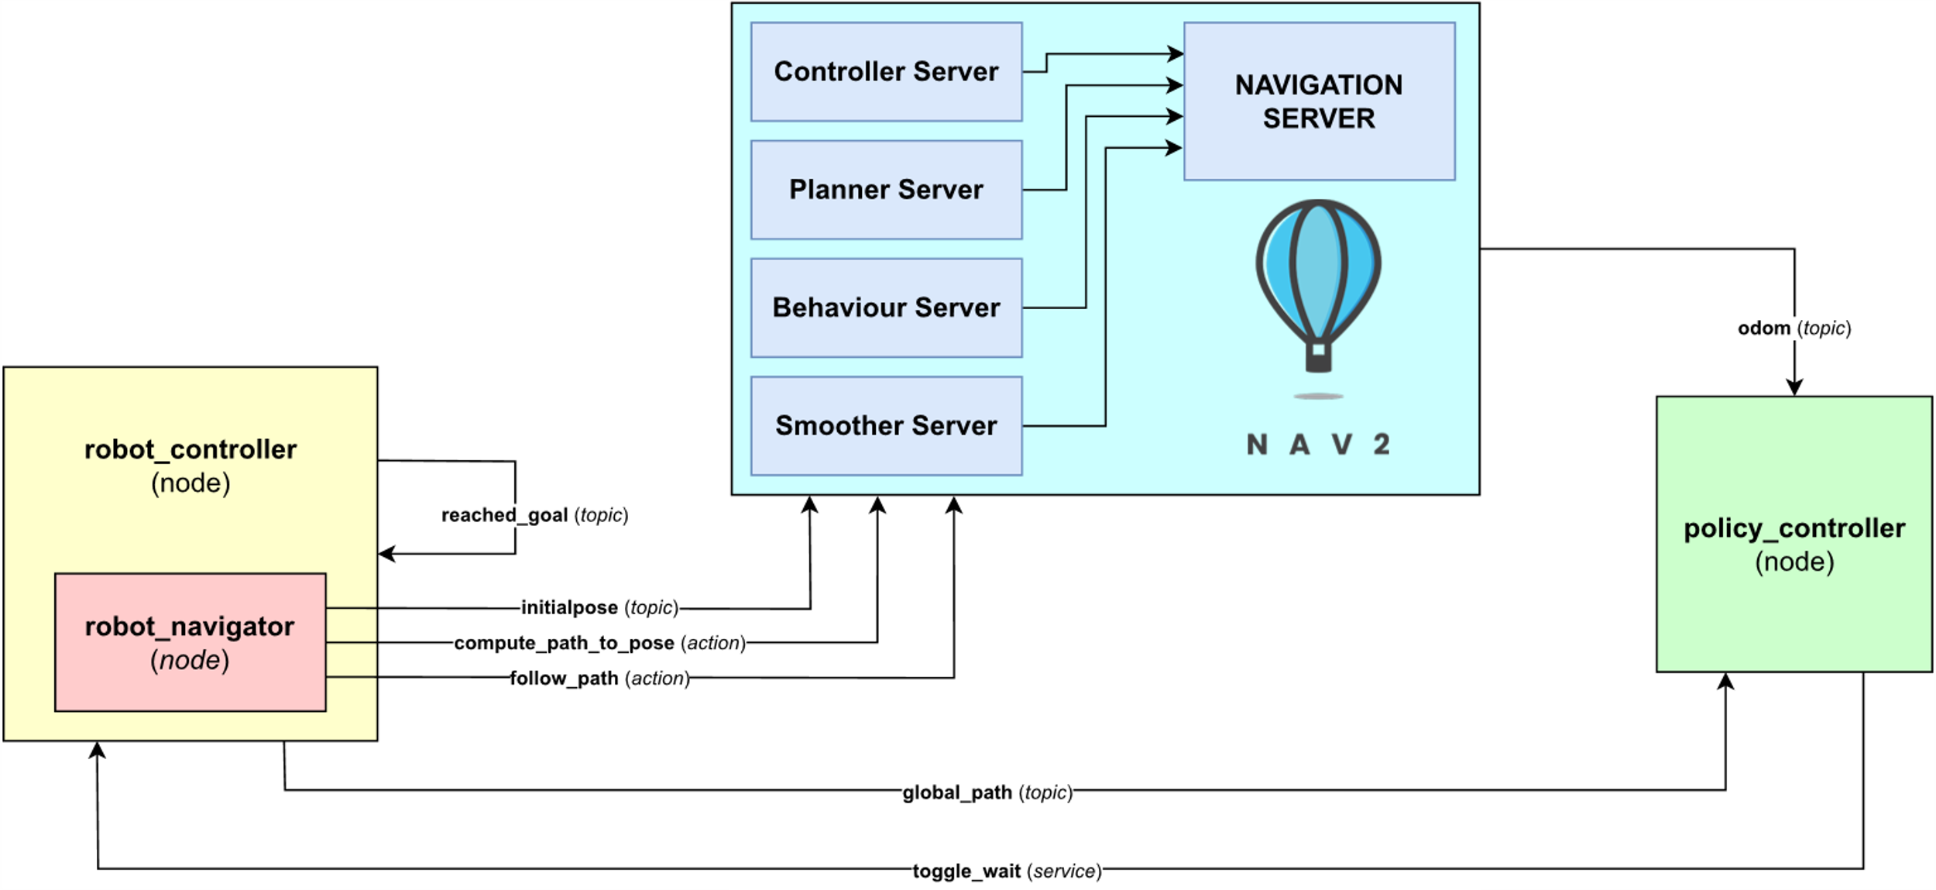
Implementation Graph

Slide 9

Implementation Details
The desired behavior is obtained through the following nodes.
The robot controller node has two main functionalities:
Setting a goal to the related robot.
Making the related robot temporarily wait.
The policy controller node has main functionalities:
Computing all the intersections between the navigation paths.
Monitoring the position of the two robots to check for collisions.
Communicating with the robot controller node to make a robot wait.

Slide 10
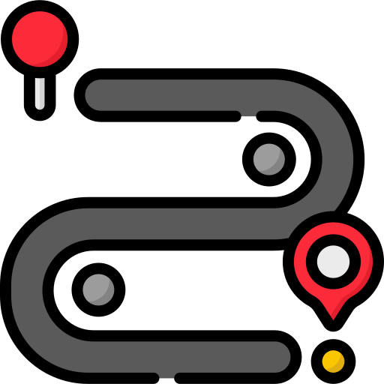
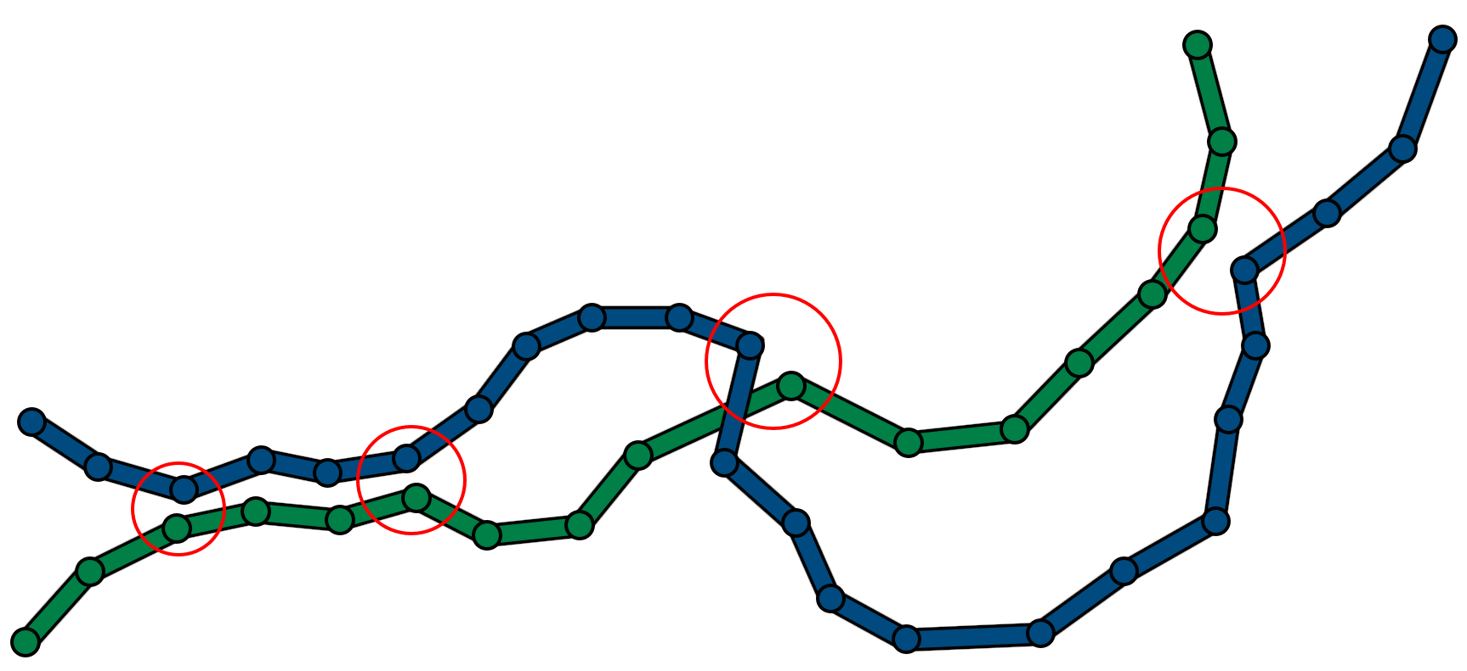
Computing the intersections
To compute the intersections between the paths, some thresholds are defined:
The path-distance threshold
The intersection-distance threshold

Slide 11

Future Work
Computing the intersections between the paths more efficiently
Use a heuristic approach to check if the robot position is close to one of the previously computed intersections
Use custom Behavior Trees (BT) plugins instead of custom nodes to manage the robot behavior

Slide 12
THANK YOU

